Slide 1
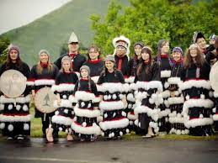
The Alutiiq tribe of Alaska
By Will Miller

Slide 2
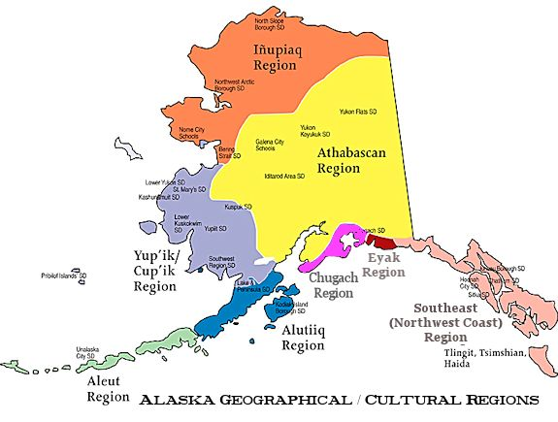
A Map of the Alutiiq Tribe
The Alutiiq tribe dwelled in southwest Alaska, towards the beginning of the Aleutian chain.
The Alutiiq territory was on the small side compared to other regions.

Slide 3
A Brief History of the Alutiiqs
The Russians forced many Alutiiqs into slavery by holding their families hostage when they arrived at the Alutiiq’s territory.

Slide 4
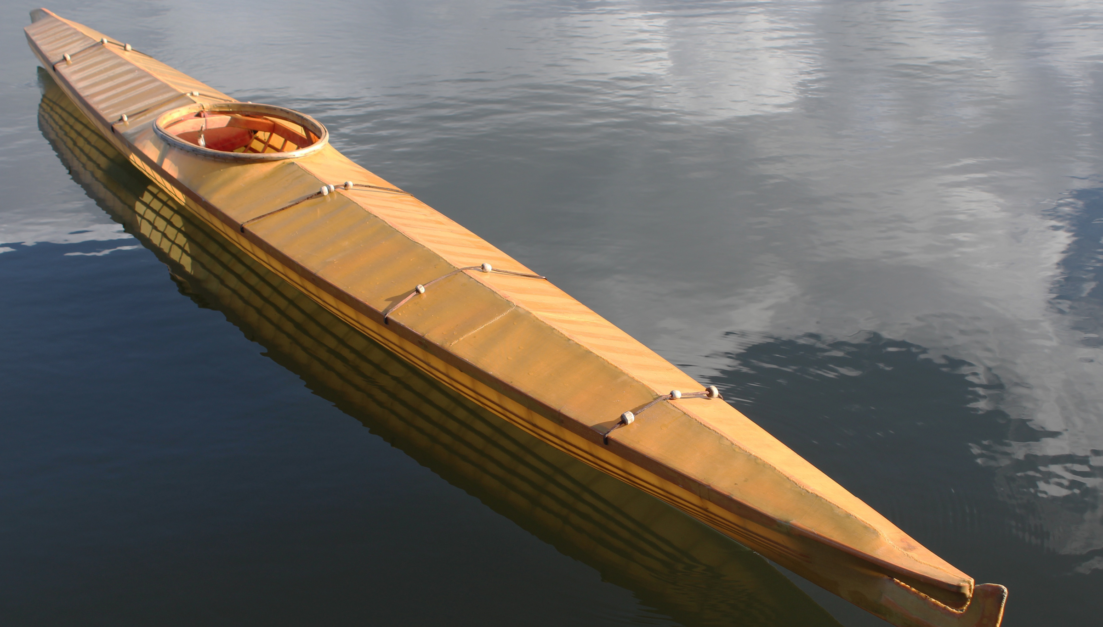
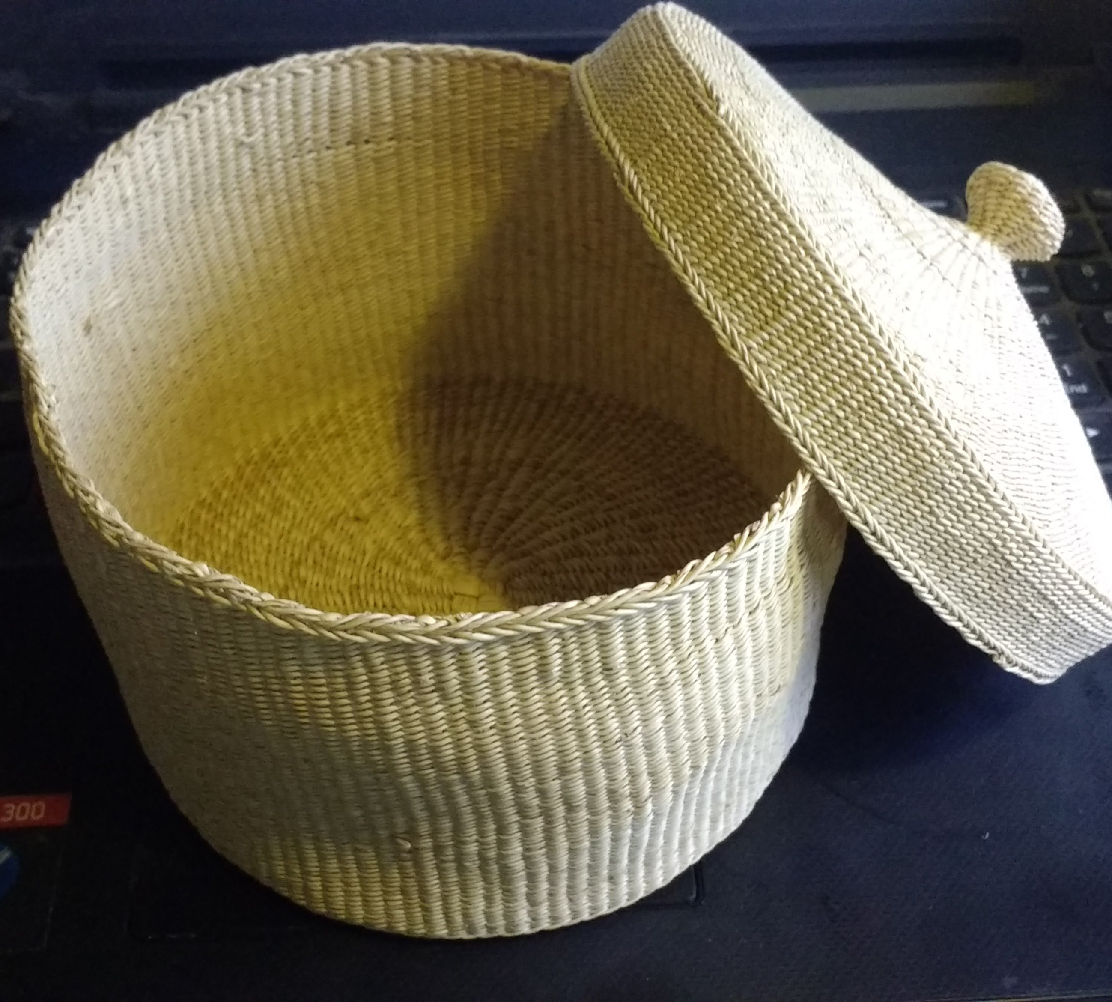
Technology of the Alutiiqs
The Alutiiqs were renowned for their remarkable baskets and carvings.
For transportation, they used baidarkas (skin boats) for speed and maneuverability.
When tools were needed for hunting, they had fishhooks, nets, spears, and whaling harpoons at the ready.

Slide 5
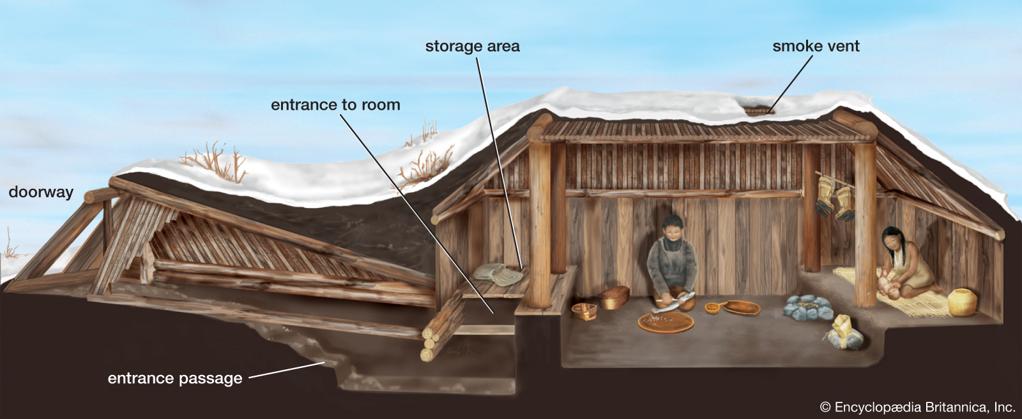
Alutiiq Shelters
Alutiiq houses were semi-subterranean. That means they were partly underground.
To construct a house, they dug a pit, built a wood frame above it, enclosed with grass mats, and concealed with sod for insulation.
Every shelter contained multiple rooms to house several families.

Slide 6
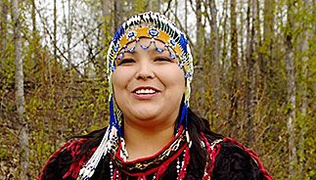
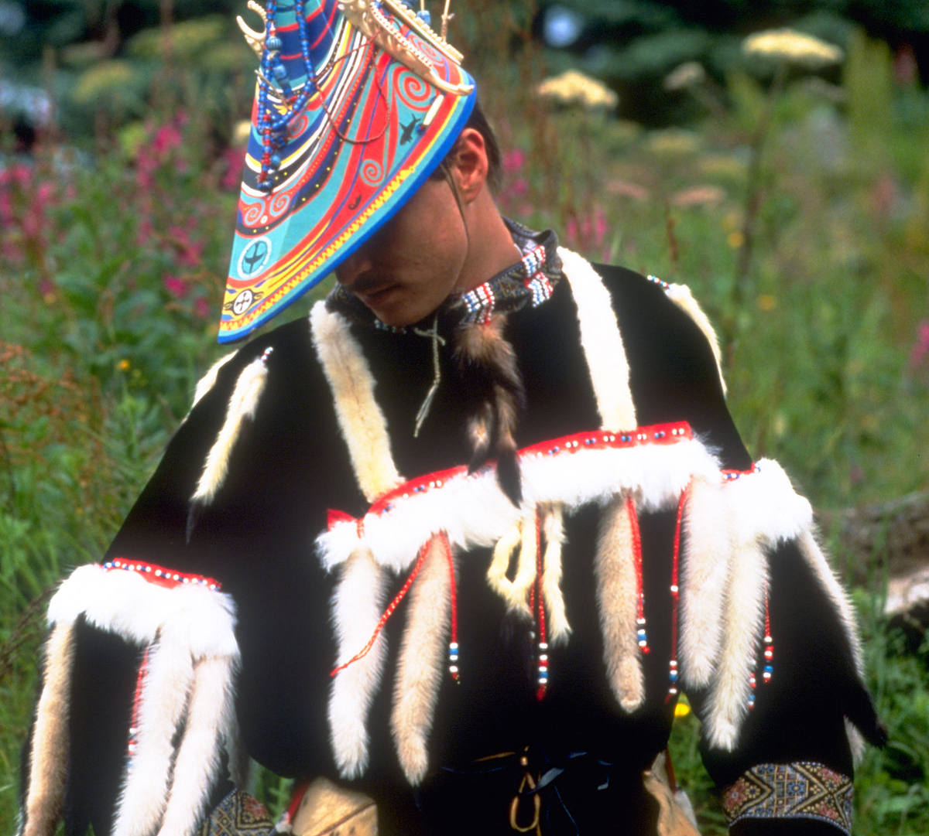
Alutiiq Clothing
Alutiiqs wore parkas, tunics, sealskin mittens, mukluks lined with grass, and long pants.
Although most of their clothes were made from sea lion skin, some parkas were made of animal intestines for water resilience.

Slide 7
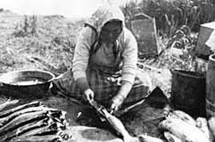
The Alutiiq Diet
Alutiiqs ate salmon, fish, seals, and other marine animals.
As well as seafood, Alutiiqs hunted birds, small game, and collected berries and other plants.

Slide 8
Alutiiq Religion and Government
Alutiiq villages were governed by a male toyuq, or chief chosen by the clan elders.
To the Alutiiqs, their religion was highly important and was carefully followed.
The Alutiiqs spoke their now endangered language. It had many words that could be confusing to learn, but it was understandable nevertheless.
For an example of an Alutiiq word, a friendly greeting in Alutiiq is “Camaii” (pronounced Cah-my.

Slide 9
Sources
Naske, C. (2021). Alutiiqs. In World Book Student.https://www.worldbookonline.com/student/article?id=ar012230
Reddish, L. and Lewis, O. (2020) Alutiiq. Native Languages of the Americashttp://www.bigorrin.org/alutiiq_kids.htm

